Slide 1




Youthify
YOUTHIFY
LEADER AHMED ESSAM AHMED
MAYAR HANY RAFIK
AHMED EHAB KAMEL
ZIAD ABDEEN KAMAL
SEIF NOUR GHOLAM

Slide 2
Youthify
WILL IT RAIN ON MY PARADE?

Slide 3

Youthify
PROBLEM & INSPIRATION
Problems Solved:
Predict air quality, fog, storm intensity, precipitation type, thermal comfort, and rainfall amounts in advance.
Transform complex weather data into simple, actionable insights.
Enable better decision-making for daily activities and safety.
General Challenges:
Synchronizing model updates and outputs.
Converting technical variables into user-friendly results.
Integrating multiple predictions into one clear interface.
Designing dynamic, temperature-based visualizations.
Inspiration:
Predict weather six months ahead for planning.
Build a user-friendly interface using the KISS principle.
Use dynamic line charts with color changes (red for hot, blue for cold).
Provide clear, actionable messages to guide user decisions.

Slide 4


YOUR SOLUTION (FEATURES & WORKFLOW)
Youthify
Will It Rain? is a comprehensive weather prediction system developed for the NASA Space Apps Challenge 2025. This project uses 6 specialized machine learning models combined with interactive visualizations to provide accurate and detailed weather forecasts for Alexandria, Egypt. The system was designed based on NASA POWER climate data from 2020 to 2023 and delivers insights with both precision and real-time interactivity.
Features
Six prediction models: Fog & Visibility, Precipitation Amount, Air Quality, Thermal Comfort, Rain Prediction, Storm Intensity.
Interactive visualizations: Multi-panel dashboards, animated time series, correlation heatmaps, live infographics, storm analysis, and weather distribution charts.
Workflow
Data collection: Fetch daily climate data (2020–2023) for Alexandria from NASA POWER API.
Data preprocessing: Clean, transform, and engineer features from raw climate data.
Model training & evaluation: Build and test regression and classification models for each weather phenomenon.
Integration: Merge all models into a unified dataset.
Visualization: Create interactive dashboards with Plotly for real-time weather insights.
User interface: Provide easy-to-use interactive tools for exploring weather predictions.
Future expansion: Integrate real-time APIs, develop a mobile app, expand coverage to other cities, and enhance models with deep learning techniques.
Impact
High accuracy weather forecasting (up to 94.7% for rain prediction).
Transforms complex climate datasets into actionable insights.
Supports safe and informed decision-making for weather-related activities.

Slide 5
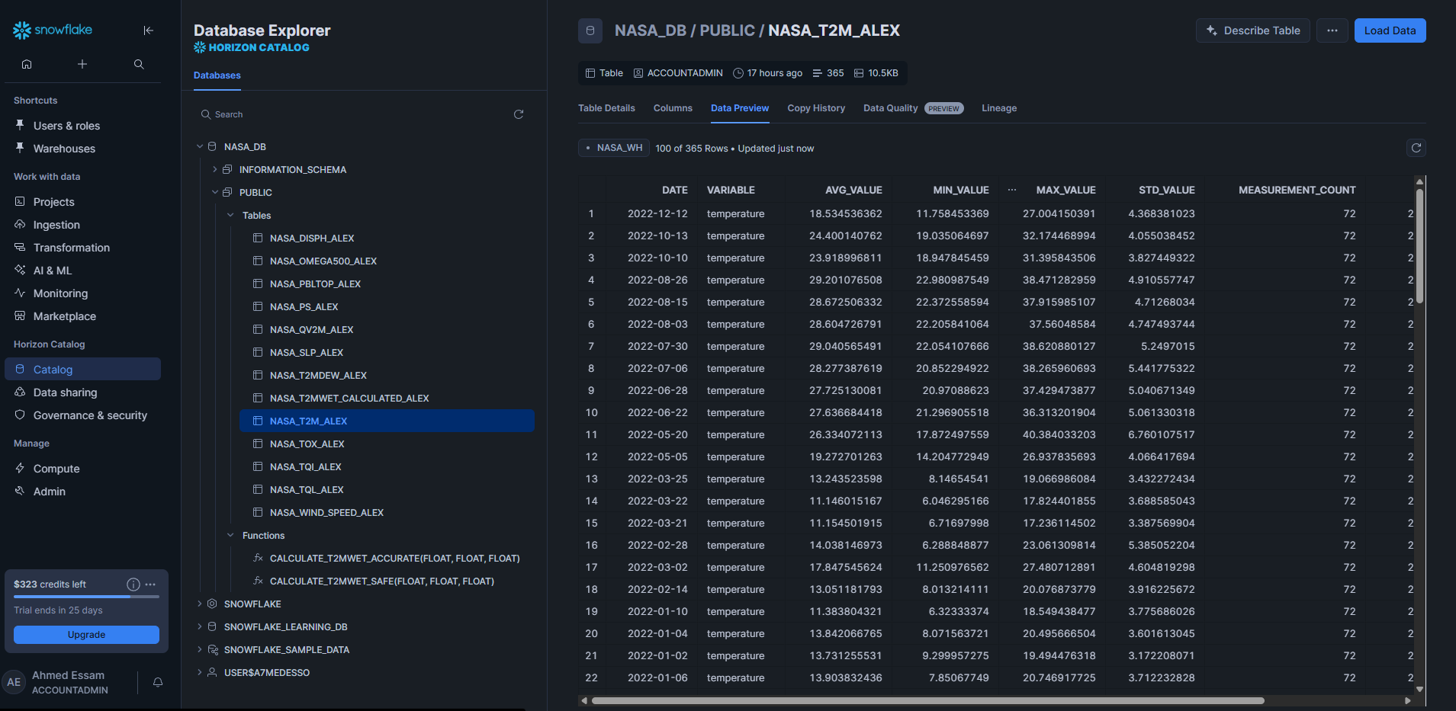
Youthify
NASA DATA & TECHNOLOGY USED
Our project "Will It Rain?" leverages a combination of NASA climate datasets and advanced data technologies to deliver accurate weather predictions for Alexandria, Egypt.
Data Sources
We used NASA POWER climate data with the following key variables:
Core Weather Variables
T2M — Air temperature at 2 meters (°C)
QV2M — Specific humidity (g/kg)
T2MDEW — Dew point temperature (°C) — critical for precipitation prediction
Wind & Pressure Variables
U10M, V10M — Wind components (m/s)
PS — Surface pressure (kPa)
SLP — Sea level pressure (kPa)
Advanced Moisture Variables
T2MWET — Wet-bulb temperature
TQI — Ice content in clouds (kg/m²)
TQL — Liquid water content (kg/m²)
OMEGA500 — Vertical velocity at 500mb (Pa/s)
DISPH — Displacement height
PBLTOP — Planetary boundary layer top height
TOX — Total ozone concentration
Technologies Used
Snowflake — Cloud data warehouse for efficient storage and querying of NASA climate data.
Dagster Cloud: Orchestration platform for managing and monitoring data pipelines.
Visual Studio Code — Development environment for coding and notebook editing.
GitHub — Version control and project collaboration.
Google Colab — Interactive Jupyter notebook environment for model development and testing.
Plotly — Interactive data visualizations and dashboards.
ChatGPT — AI tool for generating ideas, explanations, and code snippets.
DeepSeek — AI-powered data analysis and insights.

Slide 6
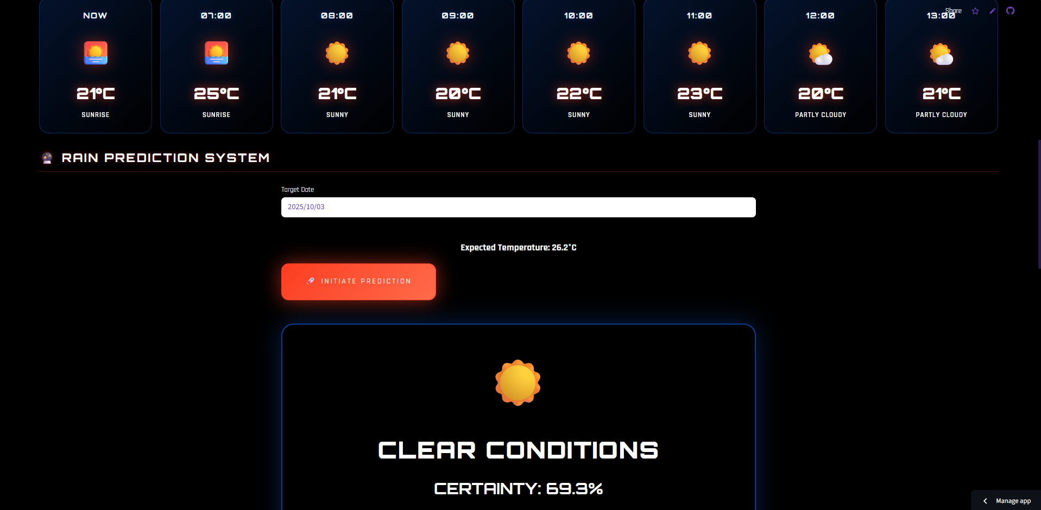


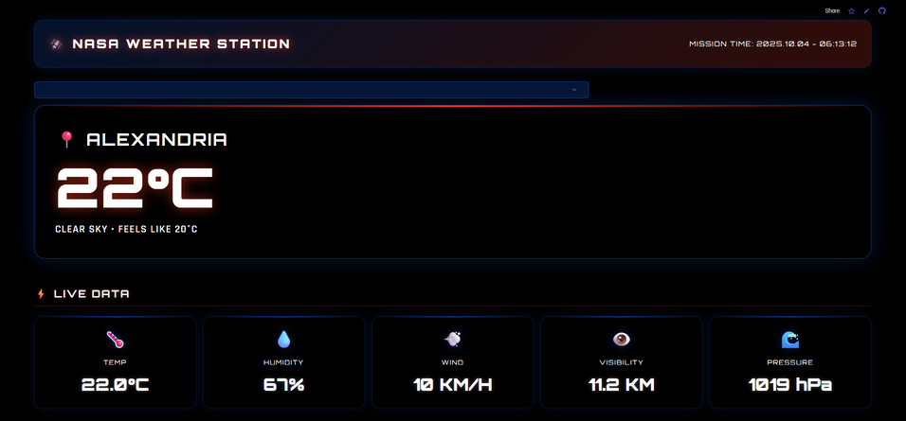
USER EXPERIENCE (SCREENSHOTS, MOCKUPS, DEMO IMAGES)
Youthify
“Will It Rain?” project emphasizes an intuitive and interactive user experience to help users easily understand weather predictions and related climate insights.
Key UX Elements:
Multi-panel Weather Dashboard with color-coded panels.
Interactive Visualizations using Plotly (charts, animated graphs, heatmaps).
User Journey:
Access dashboard.
Select weather variable/prediction model.
View interactive visualizations.
Interpret predictions with
feature importance and accuracy metrics.
GitHub Repository: https://github.com/Ahmed-Esso/WillItRain-Youthify?tab=readme-ov-file
Live Project: https://willitrain-youthify.streamlit.app/
Mockups & Screenshots:
Main dashboard mockup for Alexandria, Egypt.
Rain Prediction output screen with accuracy scores.
Storm Intensity view with R² score, RMSE, and graphs.
Demo Images:
Jupyter Notebook prediction outputs.
Combined weather model interface mockup.

Slide 7


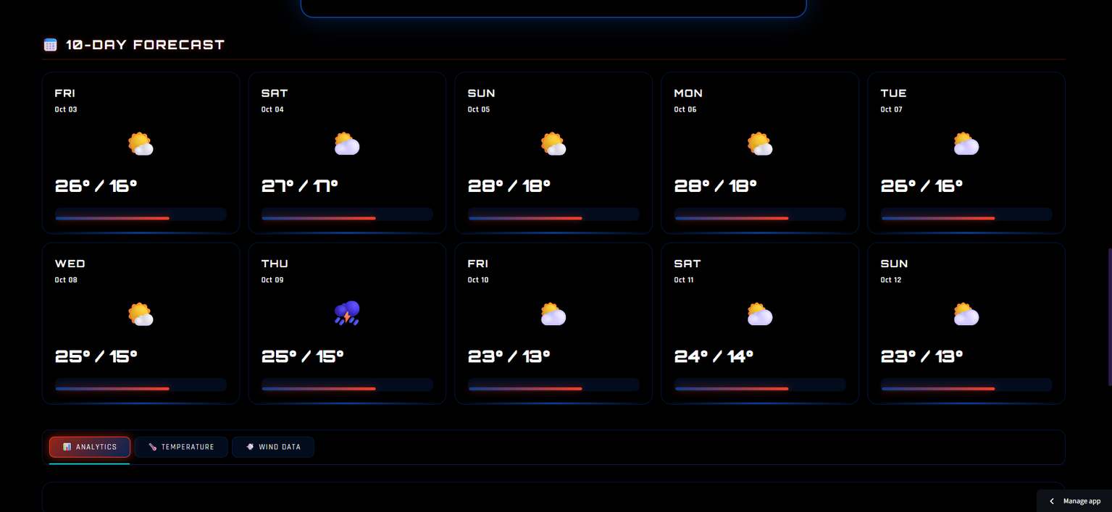
Youthify
FUTURE IMPACT & NEXT STEPS
This project has the potential to transform how people understand and prepare for weather events, making forecasts smarter and more accessible. Next steps involve enriching the model with additional NASA datasets, using cutting-edge machine learning to boost accuracy, scaling the platform to cover global regions, and creating a mobile-friendly version so anyone, anywhere, can get real-time climate insights at their fingertips.

Slide 8
Youthify
THANK YOU

